Slide 1

Employee Attrition Dashboard:
Understanding and Reducing Turnover
by Yashvinder Shokeen MABSPG23048

Slide 2
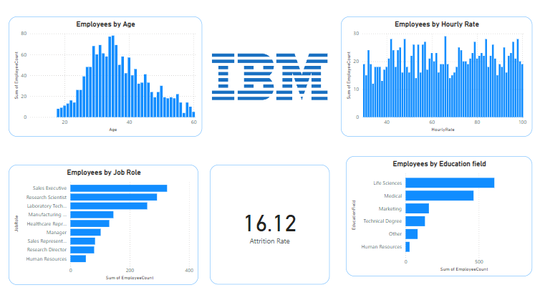

DASHBOARD (POWER BI)

Slide 3
Key Metrics Overview
Overall Attrition Rate
Attrition by Job Role
The overall attrition rate for IBM is 16.12%. This figure provides a baseline understanding of employee turnover within the organization.
Analyzing attrition across different job roles reveals significant variations. Roles like Sales Representative (39.76%) and Laboratory Technician (23.93%) exhibit notably higher attrition rates compared to others. These disparities suggest potential issues with job satisfaction or role-specific challenges.

Slide 4

Factors Influencing Attrition
Attrition Based on Monthly Income
Attrition by Overtime
Performance Rating and Attrition
Employees working overtime have a significantly higher attrition rate (30.53%) compared to those who do not (10.43%). This suggests that excessive overtime can lead to burnout and negatively impact retention.
The attrition rate remains relatively consistent across different performance ratings (16.07% for a rating of 3 and 16.37% for a rating of 4). This implies that performance rating alone may not be a strong predictor of attrition.
Employees earning lower salaries (Avg: $4787) tend to have higher attrition rates than those with higher salaries (Avg: $6832). This highlights the significance of competitive compensation in employee retention.

Slide 5

Key Trends and Anomalies
Job Roles with High Attrition
Sales Representatives and Laboratory Technicians exhibit higher attrition rates than other roles, indicating potential issues with job satisfaction or lack of career development opportunities.
Impact of Overtime on Attrition
Employees working overtime are nearly three times more likely to leave than those who do not, suggesting that work-life balance is a critical factor for employee retention.
Income as a Predictor
Lower-income employees tend to leave more often, suggesting that raising compensation could potentially improve retention rates.

Slide 6




Strategic Recommendations
Target Retention Efforts
Address Overtime and Work-Life Balance
Review Compensation Strategy
Focus on Sales Representatives and Laboratory Technicians to understand root causes of dissatisfaction and implement targeted programs to improve job satisfaction.
Reduce overtime reliance where possible and introduce flexible working hours or wellness programs to combat burnout.
Implement pay adjustments or incentive programs for lower-income employees to improve retention rates in that group.

Slide 7

Summary and Future Use
1
Insights Unveiled
The analysis has identified key trends in attrition related to job roles, compensation, and overtime.
2
Proactive Action
By addressing these factors, the organization can significantly reduce employee turnover and enhance productivity.
3
Continuous Monitoring
The dashboard serves as a continuous monitoring tool to track attrition trends over time, enabling HR teams to take proactive measures.
4
Future Expansion
The dashboard can be extended by adding factors like employee engagement, training opportunities, and career growth metrics.

